Slide 1




Course Name – Competitive Programming
Class Topic – Recursion and Basics
Instructor:
EditEdit MasterMaster texttext stylesstyles

Slide 2
Today’s Agenda
Last non-zero digit of the factorial
Pascal Triangle
Problem Statement - Two people meet each other
Finding Next largest number
To Count number of increasing subsequences
Longest substring problem
Reverse the individual words of the string
Decimal number to Roman Numeral

Slide 3
Today’s Agenda
Let’s Get Started

Slide 4
Last non-zero digit of the factorial
You will be given an integer n and you need to find the last non-zero digit in n!
Input: The input will be in the following format :
The first line should be the value of n.
Output: The output should be of the following format In the first line, print the last non-zero digit of n!
Example :
Input :
9
Output:
8
Explanation:
9!= 362880
Last Non Zero number is “8”

Slide 5
Today’s Agenda
Let’s go to the Learning Portal

Slide 6
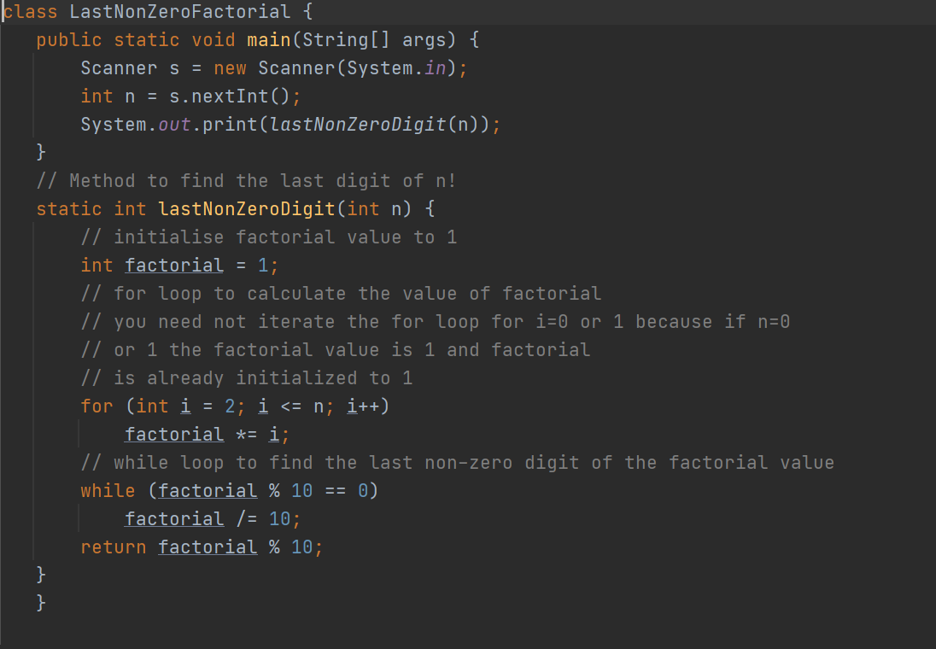
Solution: Last non-zero digit of the factorial

Slide 7
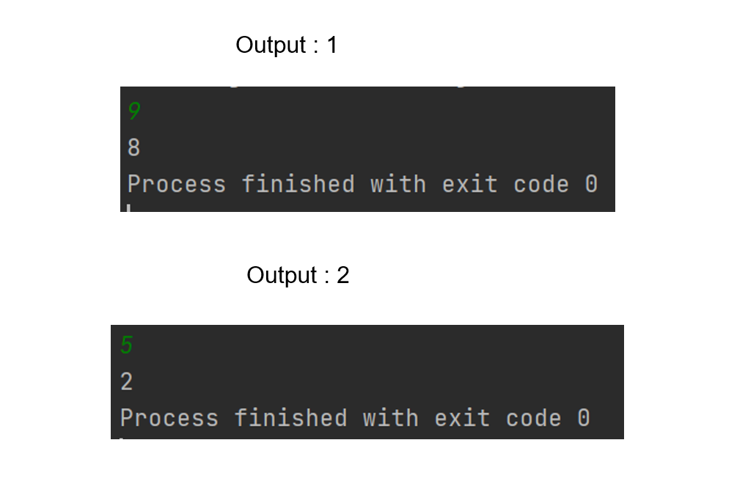
Solution: Last non-zero digit of the factorial

Slide 8
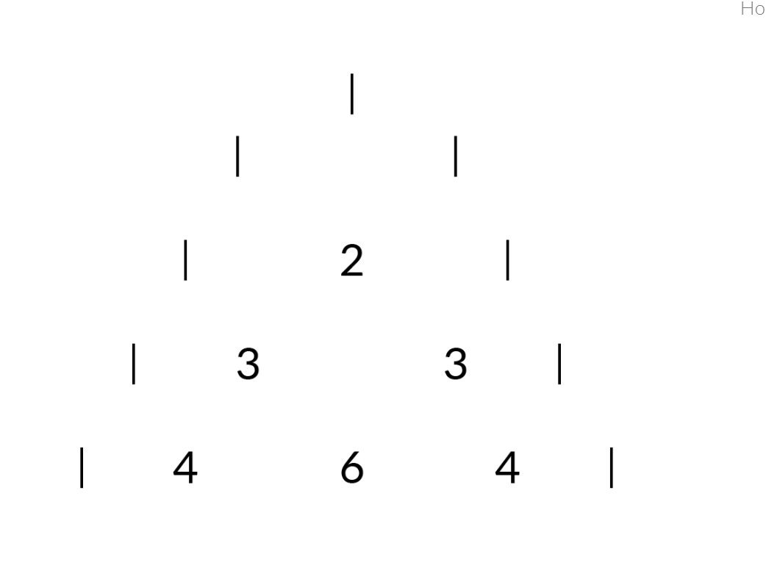
Pascal Triangle
You will be given a positive integer n. You need to print n rows in the Pascal triangle in the following format.
Input: The input will be in the following format:
1.The first line takes the value of n.
Output: The output should be of the following format:
1.Print the Pascal triangle in the format mentioned above.

Slide 9
Pascal Triangle
Example :
Input :
5
Output:
1
1 1
1 2 1
1 3 3 1
1 4 6 4 1
Explanation : Pascal’s triangle rules : - 1 should be at top of triangle and also 1 should be at 1st (i.e at left ) & also 1 should be at last (i.e right) position In every row.
And , at row 3 we got 1 2 1 because in above row (i.e at 2st row) we have 1 1 → 1+1 → 2 , as per pascals
Triangle rule we will print 1 at left and right and print the above row sum in between these 1, 1

Slide 10
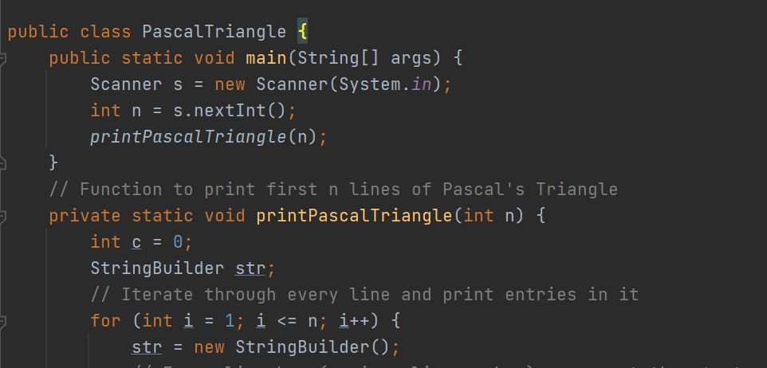
Solution: Pascal Triangle

Slide 11
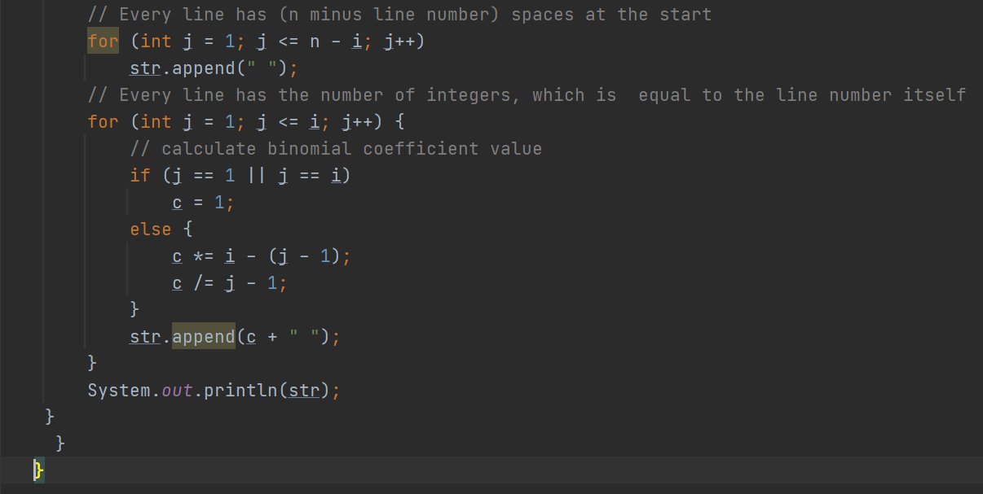
Solution: Pascal Triangle

Slide 12
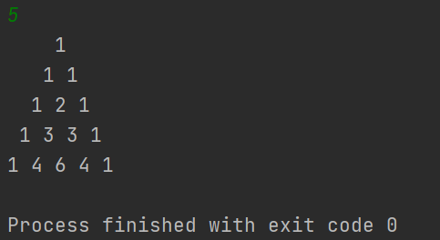
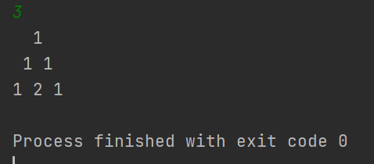
Solution: Pascal Triangle
Output : 1
Output : 2

Slide 13
Two people meet each other
You will be given starting points of two people p1 and p2 respectively and distance covered by two people in each jump s1 and s2 respectively. You need to find whether they meet after the same number of jumps. The starting points of the two persons should always be different.
Input: The input will be in the following format :
The first line should be the values of p1, p2 respectively space separated.
The first line should be the values of s1, s2 respectively space separated.
Output: The output should be of the following format
Print “YES” if they meet at some point after jumping for an equal number of times or else print “NO”.

Slide 14
Two people meet each other
Example:
Input:
p1: 6
s1: 3
p2: 8
s2: 2
Output: YES
Explanation:
Person1: 6->9->12
Person2: 8->10->12
They both will meet at point 12 after 2 jumps each.

Slide 15
Two people meet each other
You will be given starting points of two people p1 and p2 respectively and distance covered by two people in each jump s1 and s2 respectively. You need to find whether they meet after the same number of jumps. The starting points of the two persons should always be different.
Input: The input will be in the following format :
The first line should be the values of p1, p2 respectively space separated.
The first line should be the values of s1, s2 respectively space separated.
Output: The output should be of the following format
Print “YES” if they meet at some point after jumping for an equal number of times or else print “NO”.

Slide 16
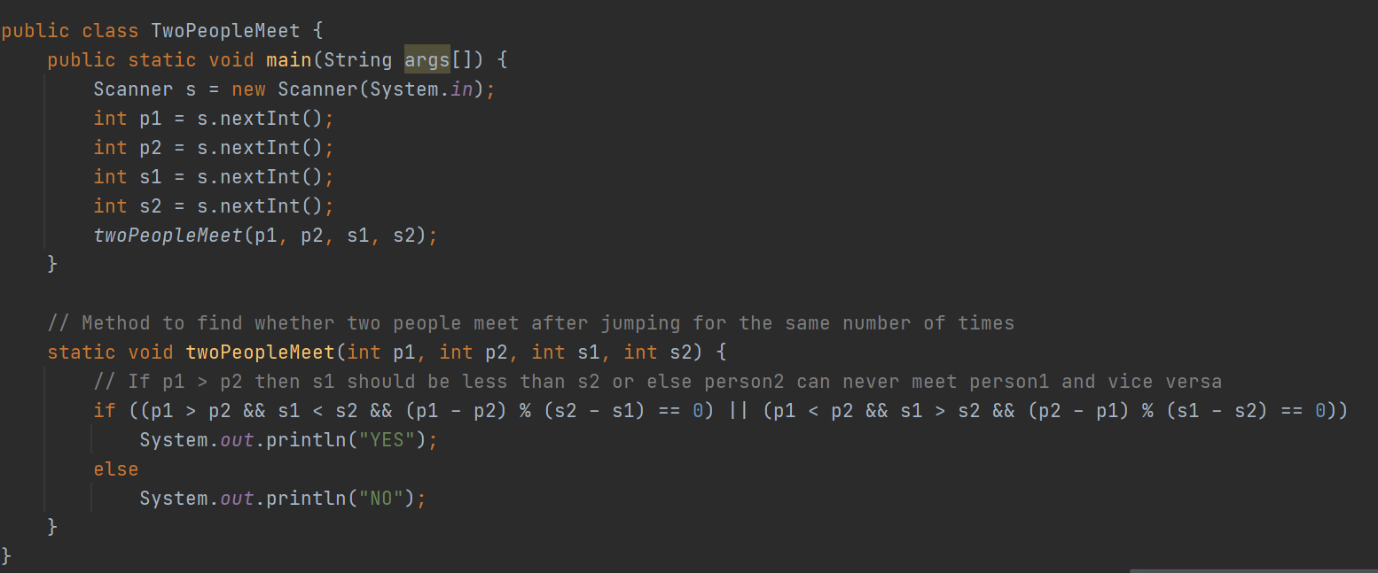
Solution: Two people meet each other

Slide 17
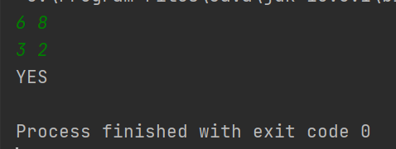
Solution : Two people meet each other
Output :

Slide 18
Finding next largest number
You are given a string which represents a number. You need to find the next largest number possible by swapping a single digit.
Example:
Input: 2187654
Output: 2487651
Explanation: Swap 1 and 4 in the input to get the next largest number given in the output.
The approach is to find the rightmost digit which is less than the digit to its right. Let that index be i. In the example (input) given above, this digit is 1.
Then find the minimum digit that is greater than the digit at ith index and is to the right of the ith index. In the example (input) given above, this digit is 4.
Swap these two digits.

Slide 19
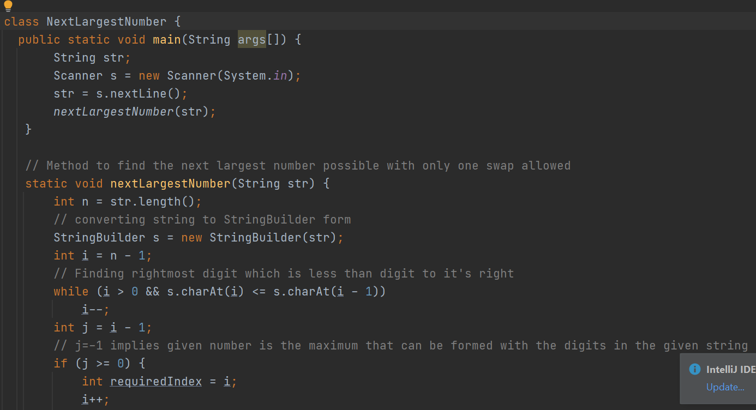
Solution : Finding Next Largest Number

Slide 20
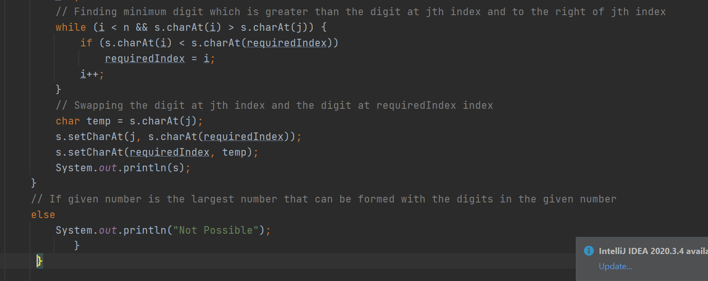
Solution : Finding Next Largest Number

Slide 21
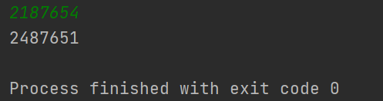
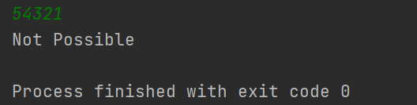
Solution : Finding Next Largest Number
Output :1
Output :2

Slide 22
To Count number of increasing subsequences
You are given an array of digits (values lie in range from 0 to 9). The task is to count all the sub sequences possible in array such that in each subsequence every digit is greater than its previous digits in the subsequence.
Example:
Input : arr[ ] =[1,2,3,4};
Output : 15
Explanation :-
There are total increasing subsequences
{ 1 }, { 2 } ,{ 3 } , { 4 } , { 1 , 2 } , { 1 , 3 } , { 1 , 4 } ,
{ 2 , 3 } , { 2 , 4 } , {3 , 4 } , { 1 , 2 , 3 } , { 1 , 2 , 4 },
{ 1 , 3 , 4 } , { 2 , 3 , 4} , { 1 , 2 , 3 , 4}

Slide 23
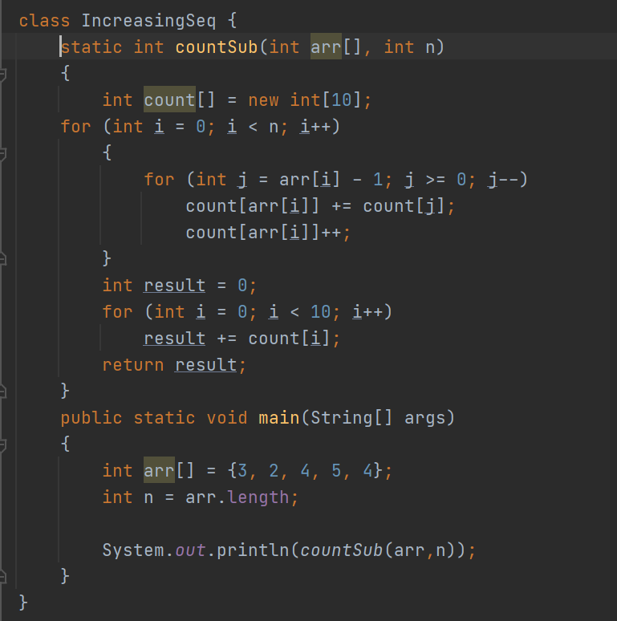
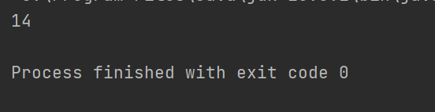
To Count number of increasing subsequences
Output

Slide 24
Longest Substring Problem
You will be given two strings ‘X’ and ‘Y’ , find the length of the longest common substring
Example :
Input X = “ABC” , Y = “BABA”
Output : 2
Explanation:
Here Longest common substring is “AB” and is length of 2.
Input X = “abcdxyz” , Y = “xyzabcd”
Output : 4
Explanation:
Here Longest common substring is “abcd” and is length of 4.

Slide 25
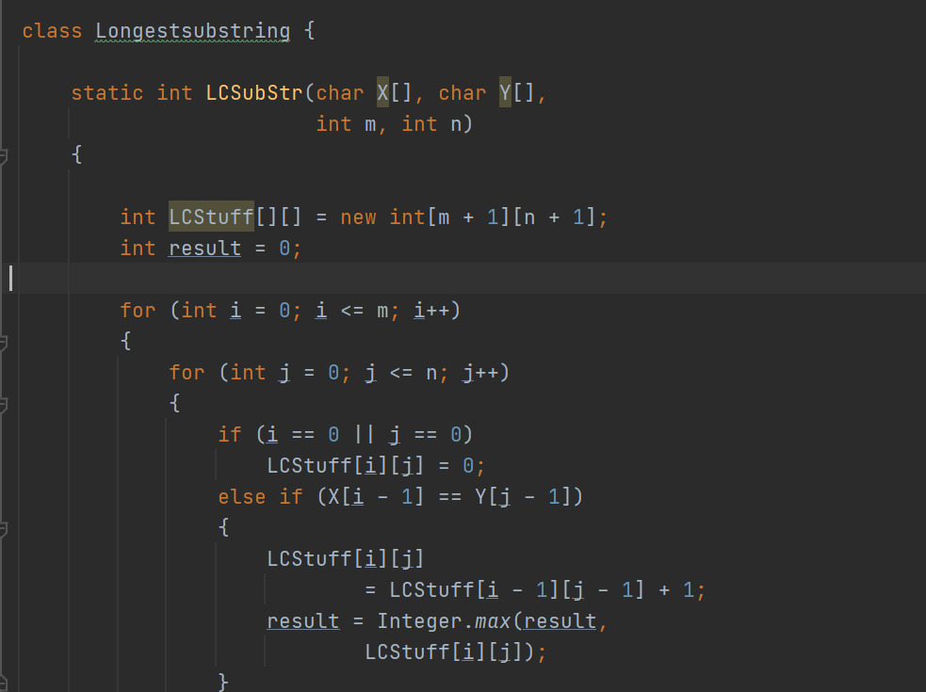
Solution : Longest substring problem

Slide 26
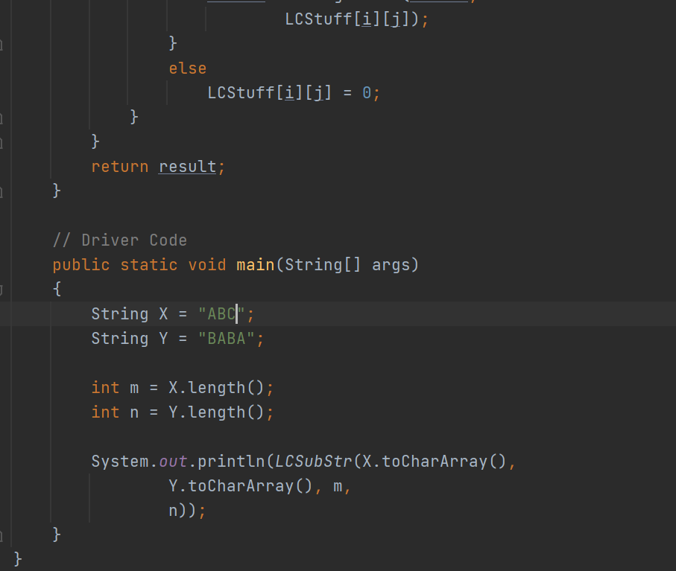
Solution : Longest substring problem

Slide 27
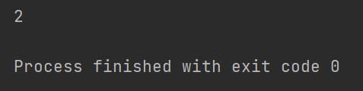
Solution : Longest substring problem
Output

Slide 28
Reverse the individual words of the string
You’ll be given a string str, you need to print reverse of individual words.
Examples:
Input : Hello World
Output : olleH dlroW
Explanation:-
Reverse of hello → 0lleh
Reverse of world → dlroW
Input : Reverse individual words
Output: esreveR laudividni sdrow
Explanation:- Just reverse words

Slide 29
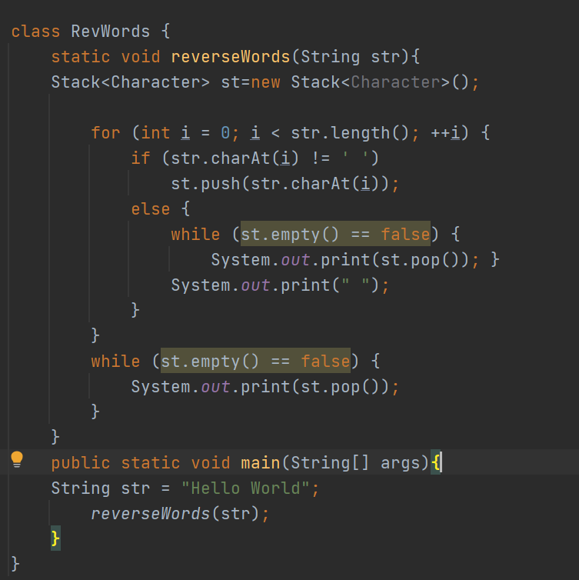

Reverse the individual words of the string
Output

Slide 30
Decimal to Roman number
You will be given a decimal number, Your task is to convert that decimal number to Roman number.
Examples :
Input :9
Output : IX
Input : 40
Output : XL
Explanation :-
Roman number of 1 is I
Roman number of 2 is II ….so on
In the same way we have the roman numbers for decimal numbers
You have to print that roman numbers

Slide 31
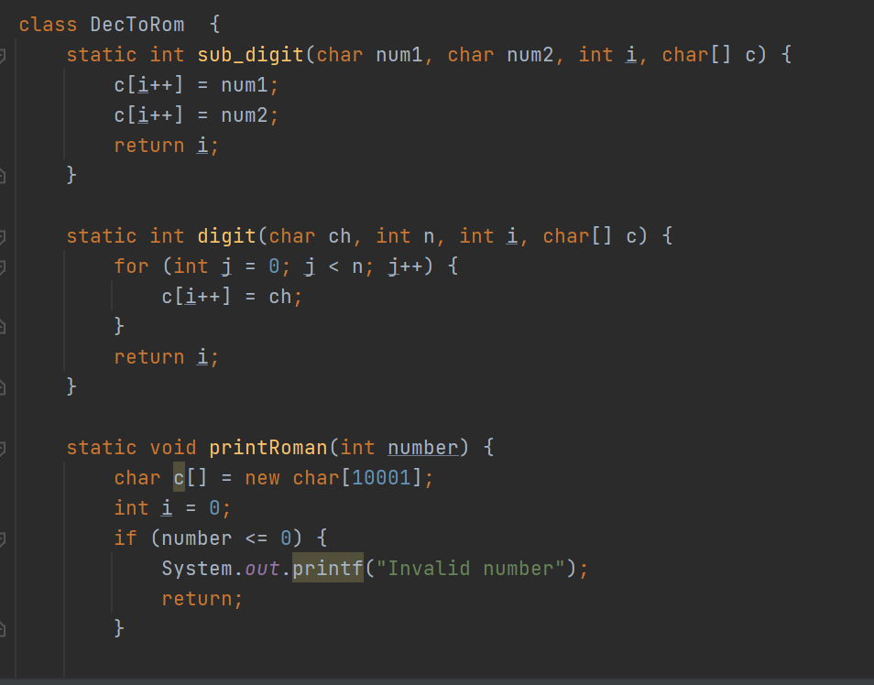
Decimal to Roman number

Slide 32
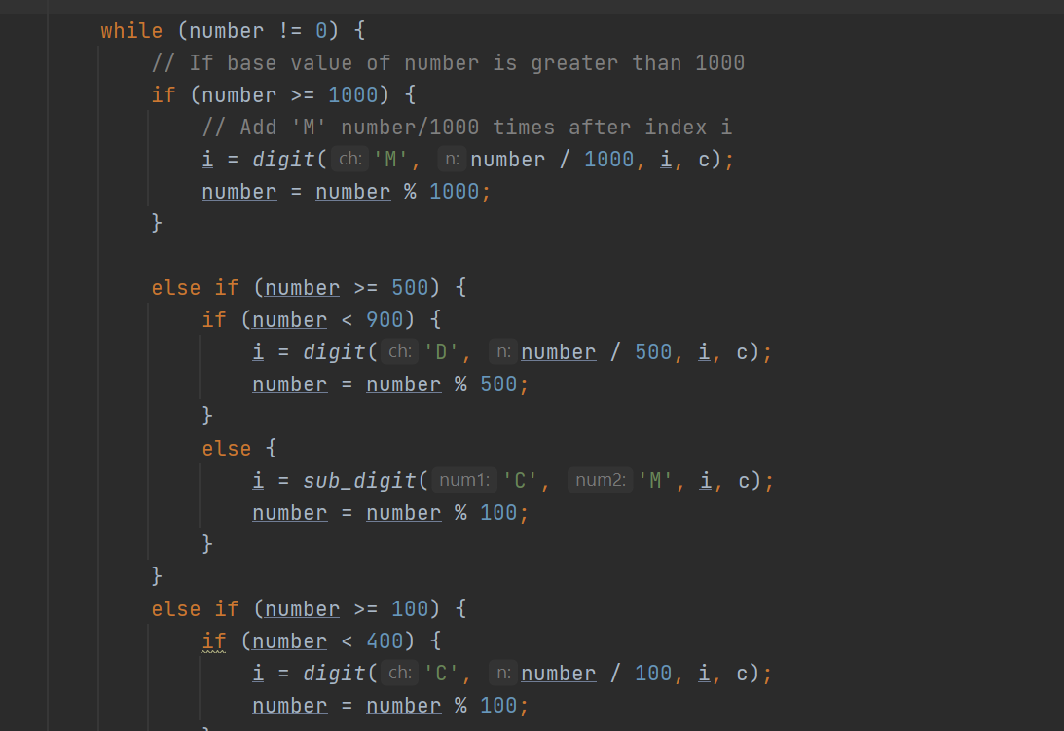
Decimal to Roman number

Slide 33
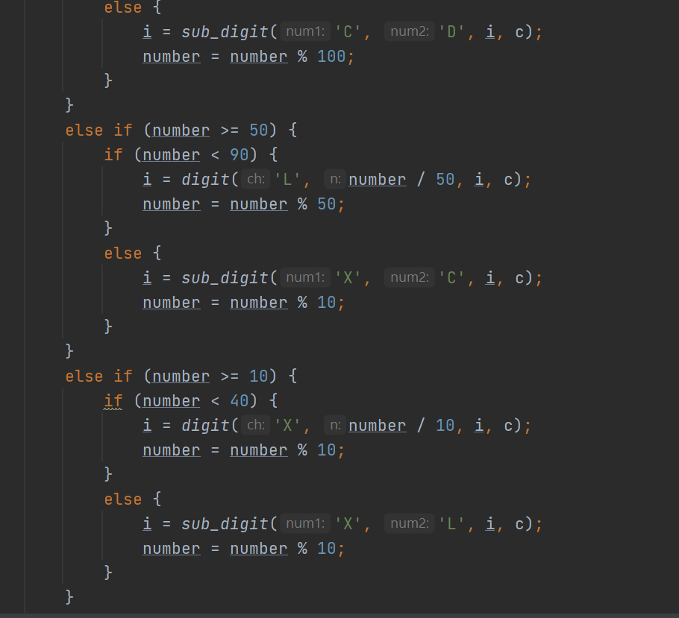
Decimal to Roman number

Slide 34
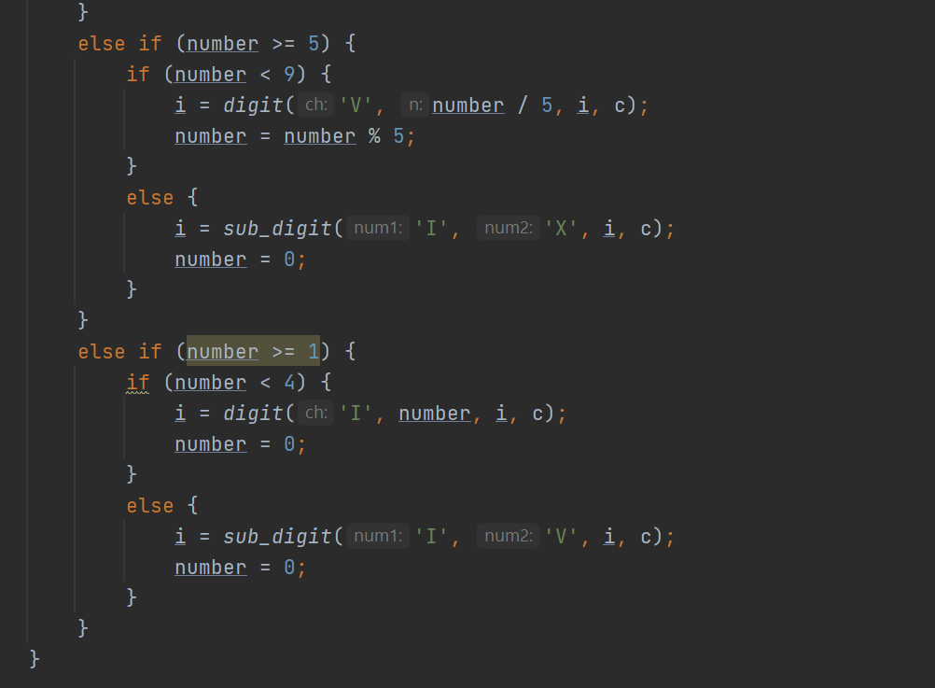
Decimal to Roman number

Slide 35
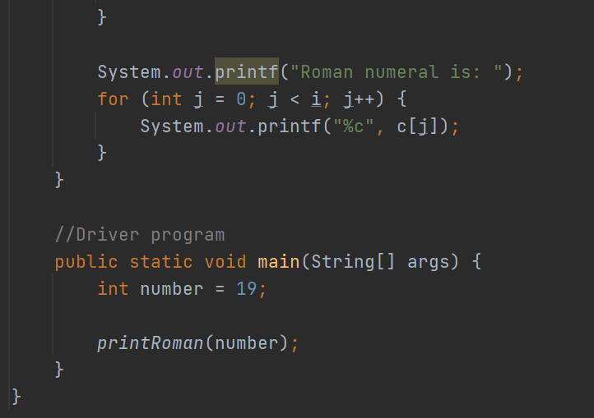
Decimal to Roman number

Slide 36

Decimal to Roman number
Output :

Slide 37
Today’s Agenda
Any Queries/Doubts???

Slide 38
Key Takeaways
We have learnt how to find ,Last non-zero digit of the factorial
We learnt how to print Pascal Triangle
We have solved --Two people meet each other problem
We learnt how to Finding Next largest number
We learnt how To Count number of increasing subsequences
We learnt how to find Longest substring
We learnt how to Reverse the individual words of the string
We also learnt how to convert Decimal number to Roman Numeral

Slide 39
Next Day Agenda
Minimum Swaps to get the sorted Array
Printing smallest k elements in the same order
Find duplicate and missing elements in O(n)
Longest Palindromic substring
Implement a stack using one queue
Find kth largest element

Slide 40

Thank you for Attending!
#SirfNaamKiNahinKaamKiDegree

